Slide 1


Juan de Souza Ferreira
Out/06/2021

Slide 2

Outline
Executive Summary
Introduction
Methodology
Results
Conclusion
Appendix

Slide 3
Executive Summary
Data collection methodology
Perform data wrangling
Perform exploratory data analysis (EDA) using visualization and SQL
Perform interactive visual analytics using Folium and Plotly Dash
Perform predictive analysis using classification modelsSummary of all results

Slide 4
Introduction
In this project, it was collected data from SpaceX API to create a dataset. With this dataset, we can extract some insights from graphic plots. We can also analyze and extract insights from Pandas DataFrames
The focus of this project is create a Machine Learning model to predict whether a landing will be successful or not for future lauches, based on data collected from the Spacex API

Slide 5


Slide 6
Methodology
Executive Summary
Data collection methodology:
The data was collected from SpaceX API, using requests library from Python. The Pandas library was used to convert JSON format (API response) to DataFrame
Perform data wrangling
Describe how data was processed
To fill null numeric data, we used the mean of the feature in question. It was used a numpy and pandas library to do that.
Perform exploratory data analysis (EDA) using visualization and SQL
We used a matplotlib library to explory and plot data. With SQL we extract some important information

Slide 7
Methodology
Executive Summary
Perform interactive visual analytics using Folium and Plotly Dash
With Folium, we can extract some information about distance and map visualization. Plotly Dash provide us a interactive way to see plots and charts
Perform predictive analysis using classification models
We used GridSearchCV to find the best parameters for Logistic Regression, SVM, Decision Tree, KNN models.

Slide 8
Data Collection
Requests library was used to get data from SpaceX API. The SpaceX API returns a data in JSON format, this data was converted into a DataFrame using a Pandas library.
BeautifulSoup (BS4) library was used to get data from Wikipedia. We parsed the HTML provided from the BS4 to Pandas DataFrame

Slide 9
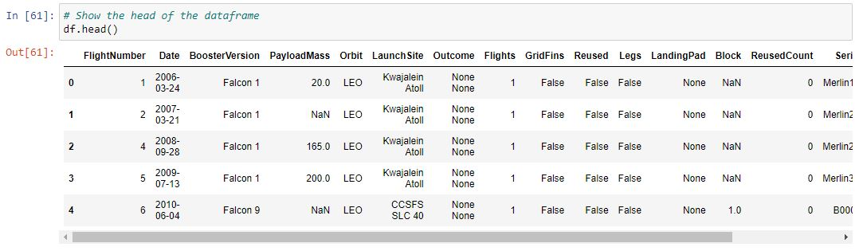
Data Collection – SpaceX API
Above we can see how data is stored into Pandas DataFrame. In Data Wrangling step, we’ll choose some features that’ll help us in the forward steps
GitHub URL of Data Collection step: Applied_Data_Science_Capstone/Data_Collection_API.ipynb at main · Juanszf/Applied_Data_Science_Capstone (github.com)

Slide 10
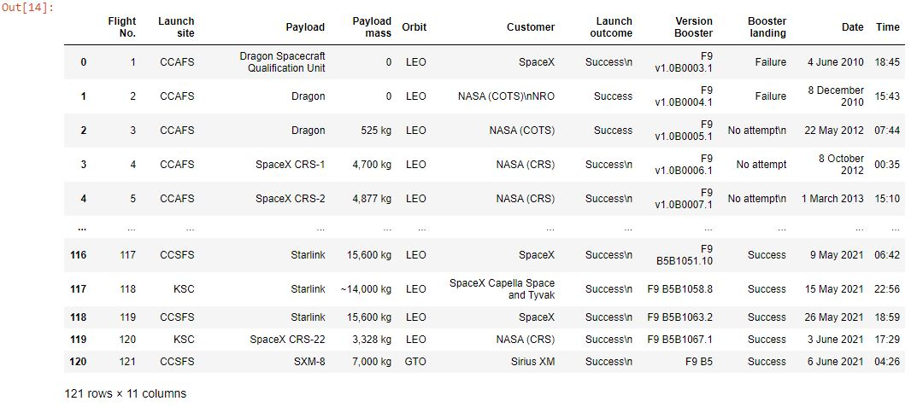
Data Collection - Scraping
Above we can see how data is stored into Pandas DataFrame. In Data Wrangling step, we’ll choose some features that’ll help us in the forward steps
GitHub URL of Data Collection step: Applied_Data_Science_Capstone/Web_Scrapping.ipynb at main · Juanszf/Applied_Data_Science_Capstone (github.com)

Slide 11
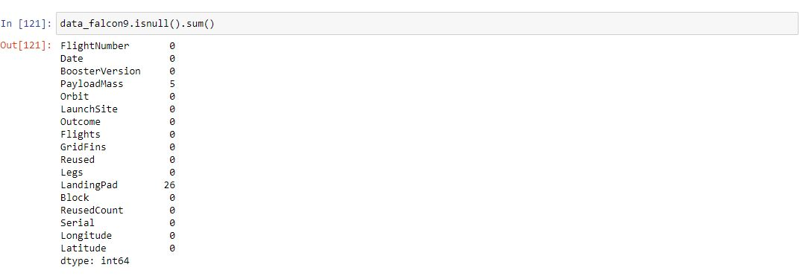
Data Wrangling
As shown above, Payload Mass column has five null values. One way to solve that is replace the null values for the mean of the Payload Mass column
We used replace method to replace the np.nan values for 6123.54 (mean of Payload Mass)

Slide 12
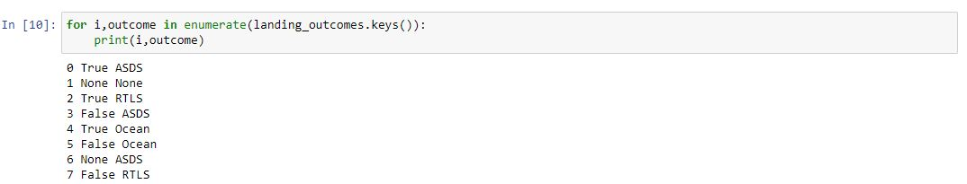
Data Wrangling
As shown above, the column “Landing Outcome” bring to us if the landing is successful or not
We associated the false results to “Class 0” and the true results to “Class 1”
The Class column was added to DataFrame, this will help us in the forwards steps
GitHub URL of Data Collection step: Applied_Data_Science_Capstone/Data_Wrangling.ipynb at main · Juanszf/Applied_Data_Science_Capstone (github.com)

Slide 13
EDA with Data Visualization
Summary of charts were plotted in this project:
Categorical Plot: It was used to visualize the relations of two features
Bar Plot: It was used to visualize the rate of successfully landing per orbit
Line Plot: It was used to visualize the increasing of successfully landing over the time
GitHub URL of Data Collection step: Applied_Data_Science_Capstone/Data_Wrangling.ipynb at main · Juanszf/Applied_Data_Science_Capstone (github.com)

Slide 14
EDA with SQL
Summary of SQL queries we performed
%%sql SELECT DISTINCT launch_site FROM SPACEXTBL
%%sql SELECT * FROM SPACEXTBL WHERE (lower(launch_site) LIKE 'cca%') LIMIT 5
%%sql SELECT sum(payload_mass__kg_) AS Total_Payload_Mass_NASA
FROM SPACEXTBL WHERE (customer LIKE 'NASA (CRS)’)
%%sql SELECT avg(payload_mass__kg_) AS avg_payload_mass_f9_v1_1
FROM SPACEXTBL WHERE (booster_version LIKE 'F9 v1.1’)
%%sql SELECT min(date) AS first_success FROM SPACEXTBL WHERE (landing__outcome LIKE 'Success (ground pad)’)
%%sql SELECT booster_version FROM spacextbl WHERE (mission_outcome LIKE 'Success') AND (payload_mass__kg_ BETWEEN 4000 AND 6000)
%%sql SELECT mission_outcome, COUNT(*) AS total FROM spacextbl GROUP BY mission_outcome
%%sql SELECT booster_version AS booster_with_max_payload_mass FROM spacextbl WHERE payload_mass__kg_ IN (SELECT max(payload_mass__kg_) FROM SPACEXTBL)
%%sql SELECT booster_version, launch_site FROM spacextbl WHERE (landing__outcome LIKE 'Failure (drone ship)') AND (year(date) = 2015)
%%sql SELECT landing__outcome as landing_outcome, COUNT(*) AS total FROM spacextbl WHERE date BETWEEN '2010-06-04' AND '2017-03-20' GROUP BY landing__outcome ORDER BY total DESC
Github URL: Applied_Data_Science_Capstone/jupyter-labs-eda-sql-coursera.ipynb at main · Juanszf/Applied_Data_Science_Capstone (github.com)

Slide 15
Build an Interactive Map with Folium
Summary of map objects we use in Folium:
Circles: It was used to indicate the launch locations
Lines: It was used to indicate the distance between the launch locations and nearest airport
GitHub URL: Applied_Data_Science_Capstone/Interactive Visual Analytics with Folium lab.ipynb at main · Juanszf/Applied_Data_Science_Capstone (github.com)

Slide 16
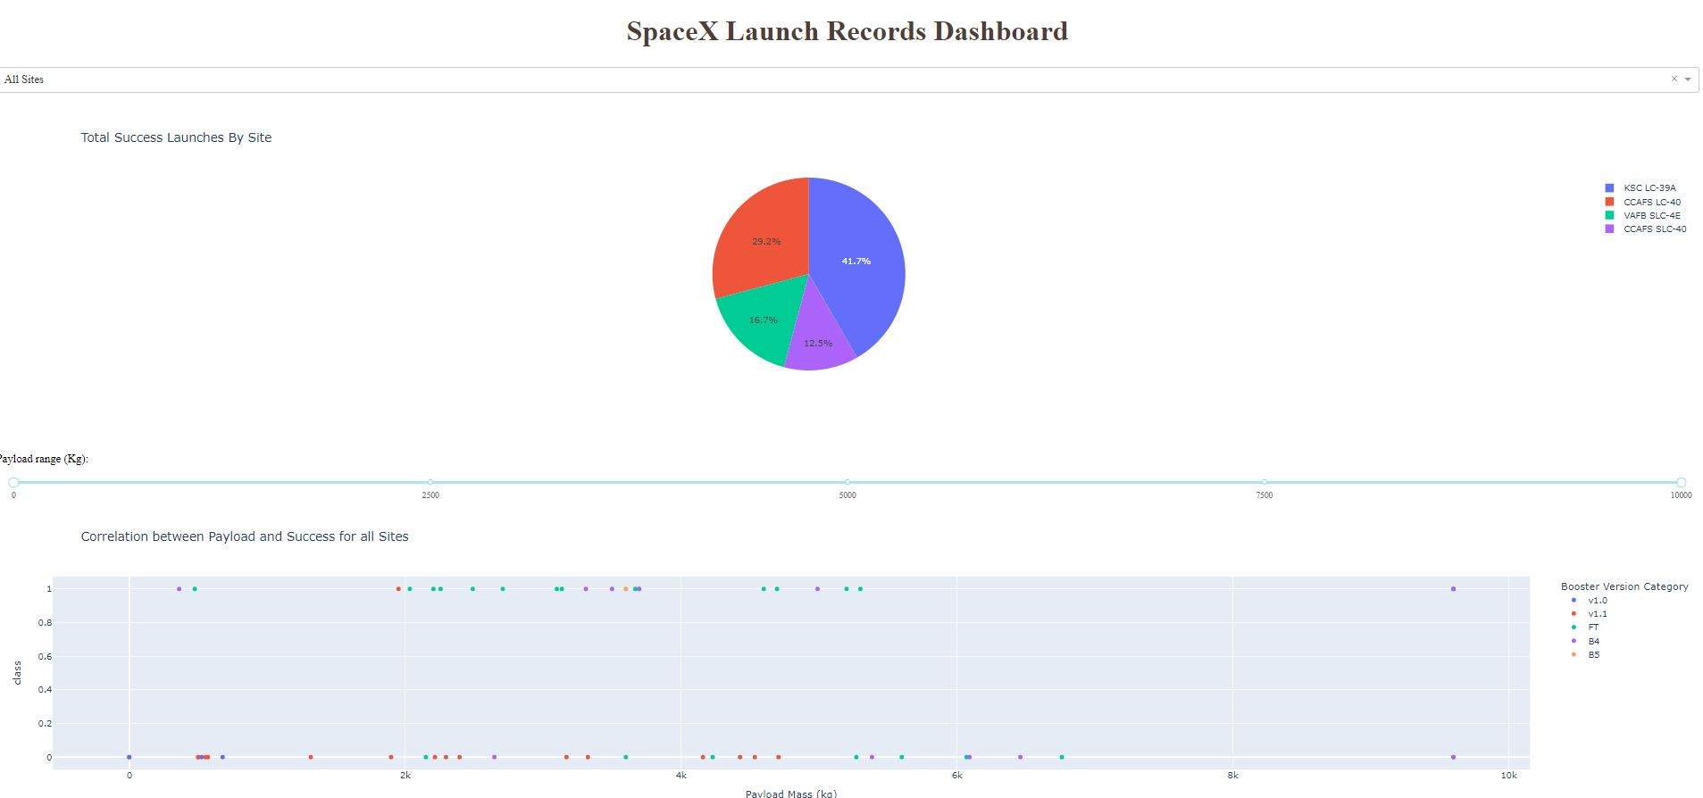
Build a Dashboard with Plotly Dash

Slide 17
Predictive Analysis (Classification)
We build four models of machine learning:
Logistic Regression
Support Vector Machine (SVM)
Decision Tree
K-nearest neighbors
GridSearchCV was used to find the best parameters for each machine learning model
GitHub URL: Applied_Data_Science_Capstone/Machine Learning Prediction.ipynb at main · Juanszf/Applied_Data_Science_Capstone (github.com)

Slide 18


Slide 19
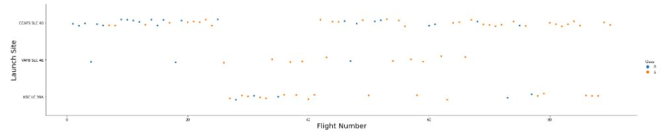
Flight Number vs. Launch Site
This plot shows an increasing of successful landing over the flight number

Slide 20
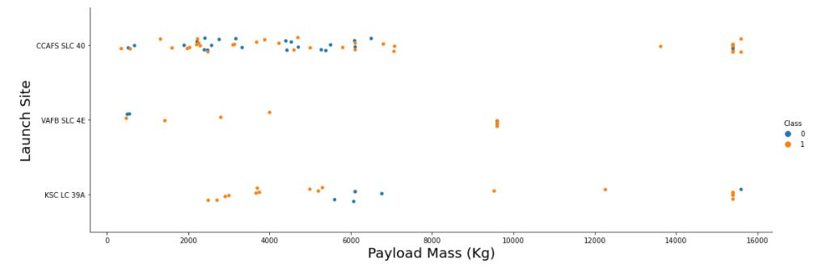
Payload vs. Launch Site
CCAFS SLC40 Analysis
CCAFS SLC 40 has more Launches then VAFB SLC 4E and KSC LC39A
Most Flights of CCAFS SLC 40 has the Payload Mass between 0 and 8000 (kg)
VAFB SLC 4E
Is often used for a specific Payload Mass, due a crowding points near 10000 (kg)
KSC LC 39A
Is the less used Launch Site, but has a interesting rate of flight success

Slide 21
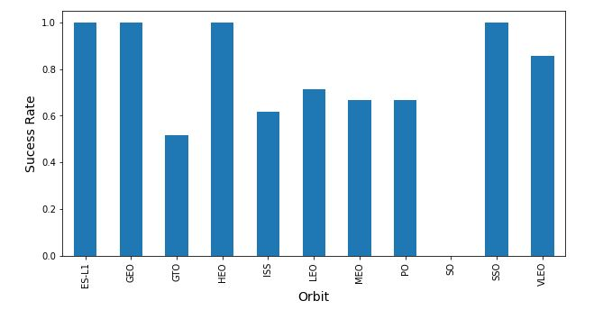
Success Rate vs. Orbit Type
ES-L1, GEO, HEO, SSO have the highest sucess rate

Slide 22
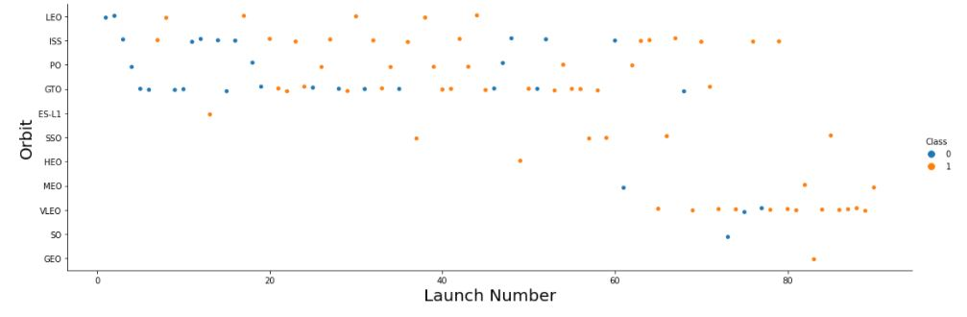
Flight Number vs. Orbit Type
ES-L1, GEO, HEO, SSO have the highest sucess rate, but they have a fewer launches

Slide 23
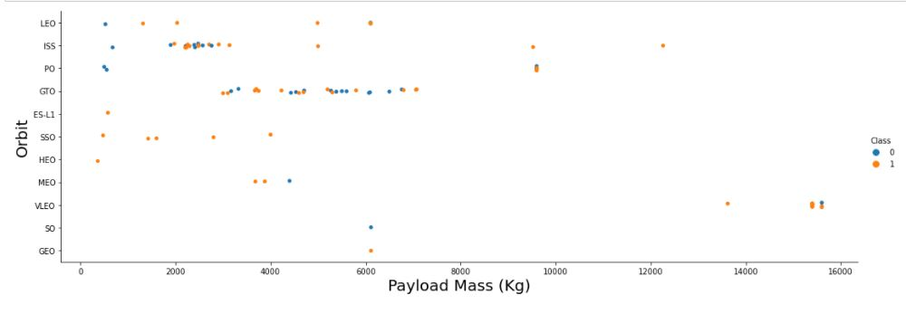
Payload vs. Orbit Type

Slide 24
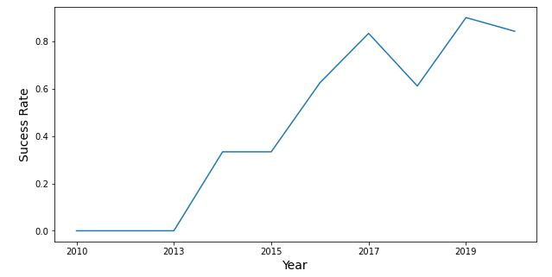
Launch Success Yearly Trend
We can observe that the sucess rate since 2013 kept increasing till 2020

Slide 25
All Launch Site Names
CCAFS LC-40
CCAFS SLC-40
KSC LC-39A
VAFB SLC-4E
%%sql SELECT DISTINCT launch_site FROM SPACEXTBL
With this query we displayed the name of all launch site names

Slide 26
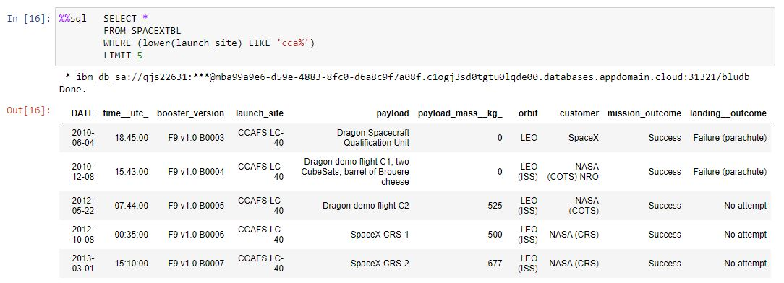
Launch Site Names Begin with 'CCA'

Slide 27
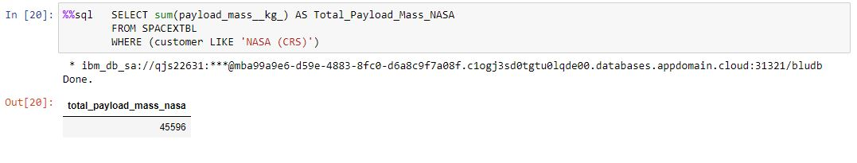
Total Payload Mass

Slide 28
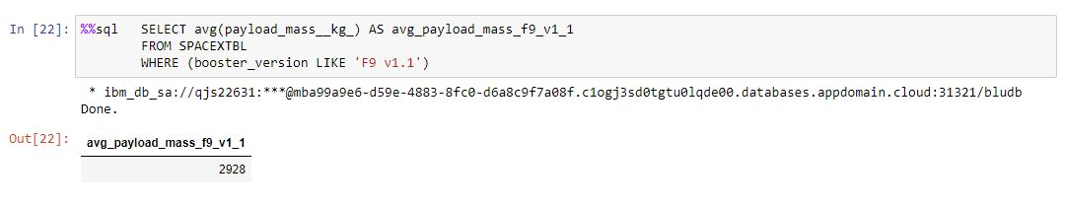
Average Payload Mass by F9 v1.1

Slide 29
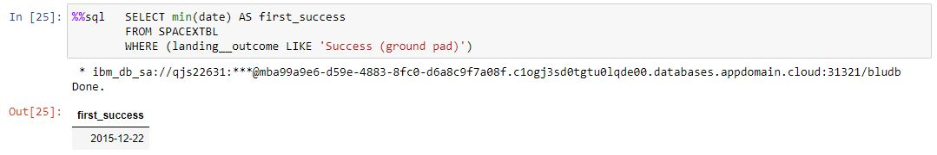
First Successful Ground Landing Date

Slide 30
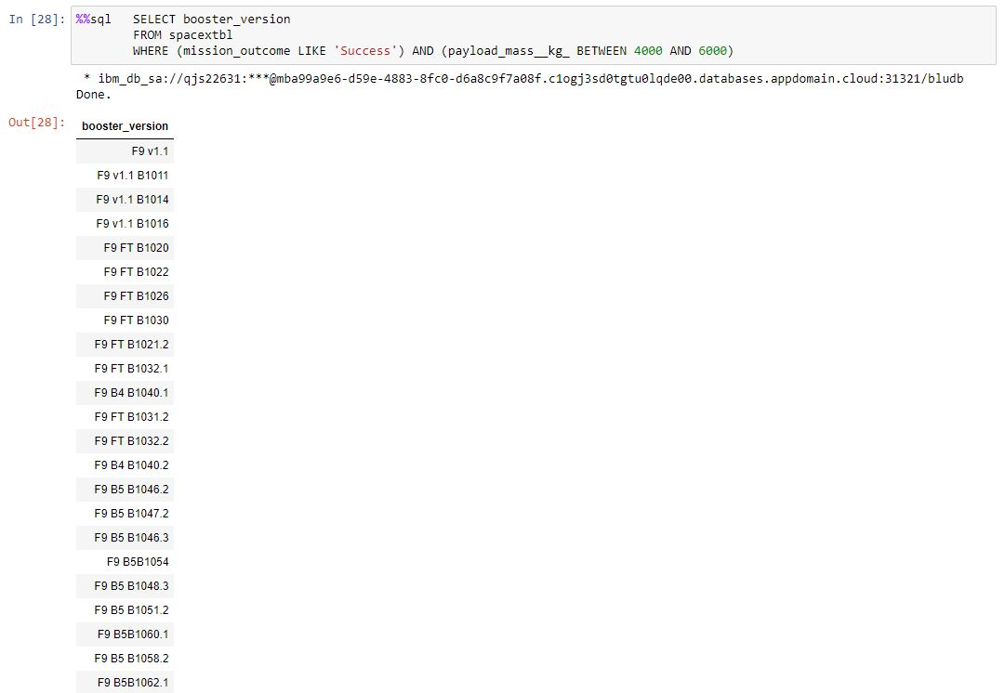
Successful Drone Ship Landing with Payload between 4000 and 6000

Slide 31
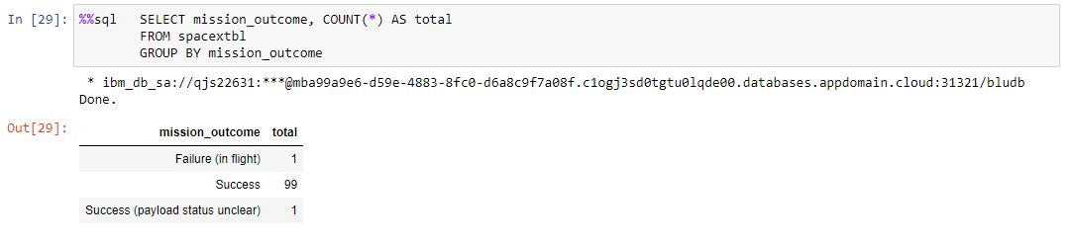
Total Number of Successful and Failure Mission Outcomes

Slide 32
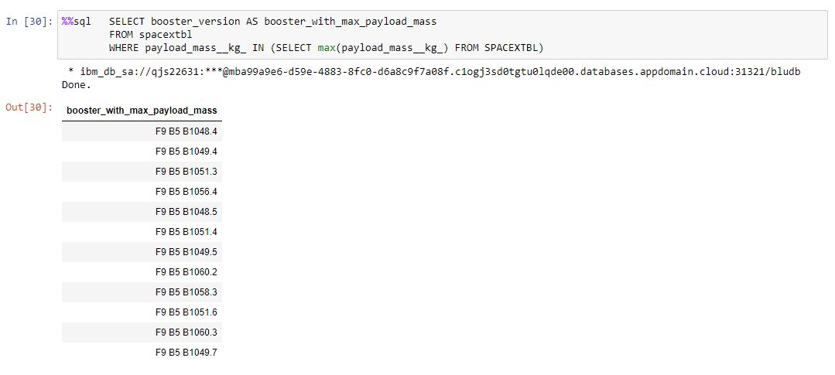
Boosters Carried Maximum Payload

Slide 33
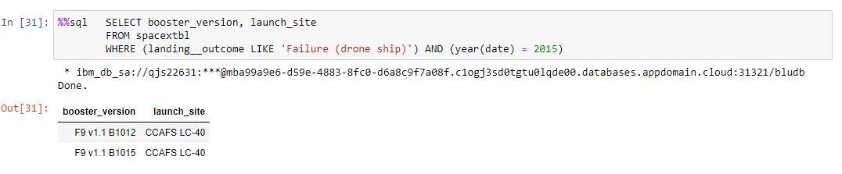
2015 Launch Records

Slide 34
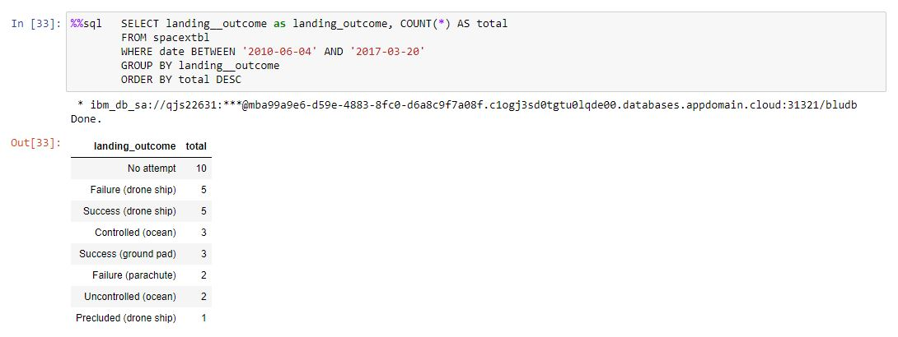
Rank Landing Outcomes Between 2010-06-04 and 2017-03-20

Slide 35


Slide 36
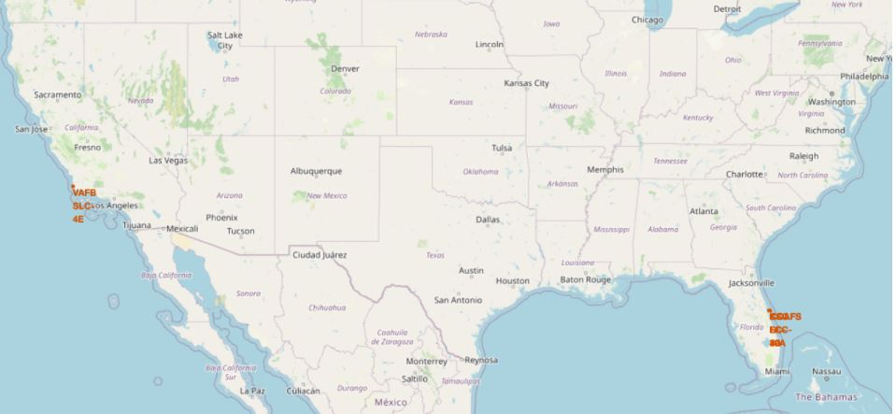
Map view of launch sites
Pins of launch site locations

Slide 37
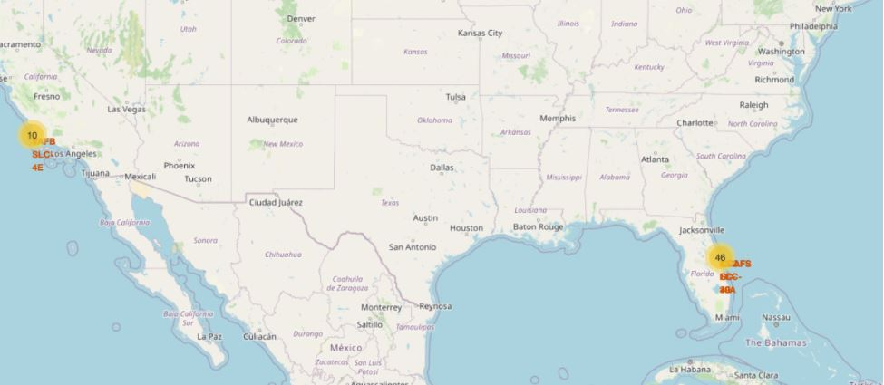
Map with launch outcomes distribuition

Slide 38
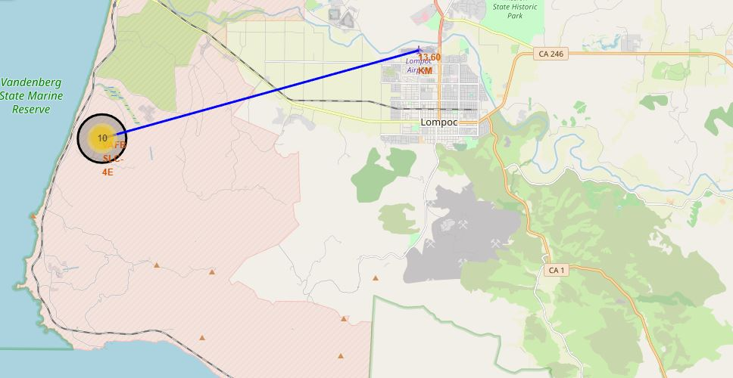
Map with the distance to nearest city airport

Slide 39


Slide 40
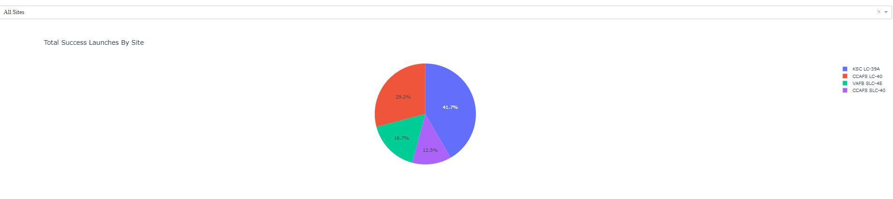
Launch Success by Launch Sites
KSC LC-39A have the highest success rate

Slide 41
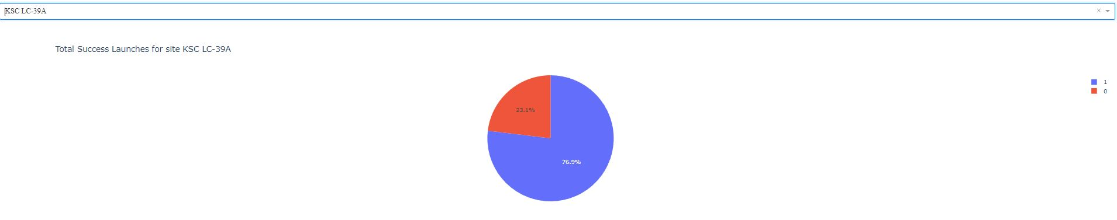
KSC LC-39A LAUNCHES

Slide 42
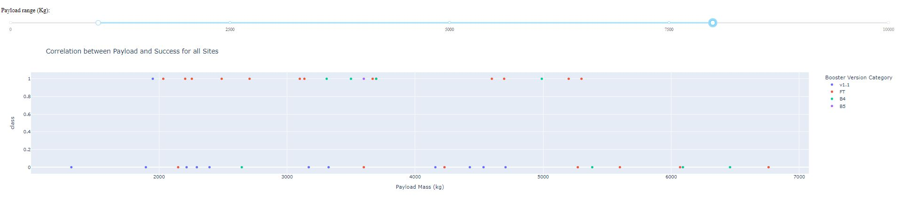
Payload Mass and Success correlation

Slide 43


Slide 44
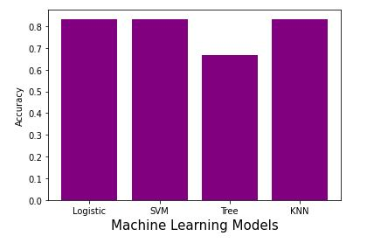
Classification Accuracy
Logistic Regression accuracy: 0,83
SVM accuracy: 0,83
Decision Tree: 0,66
KNN accuracy: 0,83

Slide 45
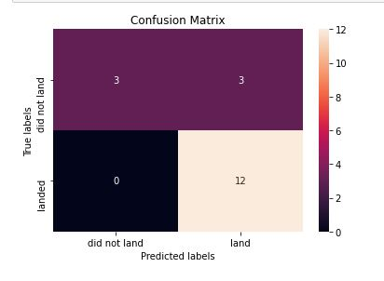
Confusion Matrix
The confusion matrix shows us that the model predicts successful landings well, but We see that the major problem is false positives.

Slide 46
Conclusions
All machine learning models have high accuracy, we can use any
We have an improvement in the successful landing rate over time, which shows an upward trend in the success rate
The launch locations have a safety distance from cities and roads
We can predict 80% of successful landing, so, we can determine the coast of 80% of launches

Slide 47


